Slide 1
Smart waste management system

Slide 2
Presented By
K.DEEKSHA
M.M.S.SAHITHI
K.R.SIVANI

Slide 3
CONTENTS
INTRODUCTION
WORKING
HARDWARE REQUIREMENTS
SOFTWARE REQUIREMENTS
CONCLUSION

Slide 4
Introduction
Smart waste management system is introduced to manage waste in big cities . Here the problem of non systematic waste collection is solved by designing an embedded iot system which will monitor the amount of waste dumped . The waste is dumped in the container and these containers are embedded with ultrasonic sensors at the top , the ultrasonic sensor is used for measuring distance . This makes it possible to measure amount of waste in the containers if one of the containers is full then an alert message is sent to corresponding personal.

Slide 5
Working
The smart waste management system monitors the garbage pins and informs about the level of garbage collected in bins via mobile application. This system uses ultrasonic sensors to detect garbage level and compare with bin depth . This makes use of ESP8266 -node MCU which is given power supply of 12V.The person receives indication of dustbin is full through application and informs the concerned person who is responsible for collection of garbage.

Slide 6
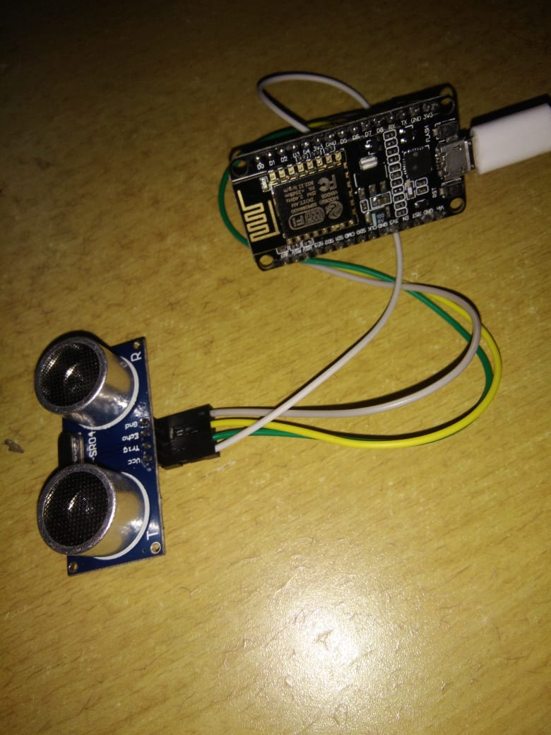

Slide 7
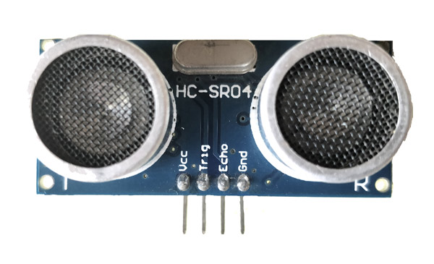
Hardware Requirements
ULTRASONIC SENSOR:-
Ultrasonic sensor is non-contact distance measurement module . It’s designed for easy modular project usage with industrial performance .In this sensor Trig pin is used for transmitter and Echo pin is for receiver which transfer frequency.

Slide 8
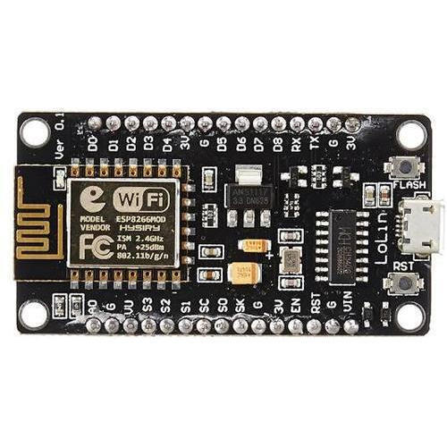
ESP8266 -node MCU:-
Node MCU is an open source Iot platform. Wi-Fi Module – ESP-12E module similar to ESP-12 module but with 6 extra GPIOs. USB – micro USB port for power, programming and debugging . Headers – 2x 2.54mm 15-pin header with access to GPIOs, SPI, UART, ADC, and power pins. Misc – Reset and Flash buttons . Power supply – 5V via micro USB port . Dimensions – 49 x 24.5 x 13mm.

Slide 9
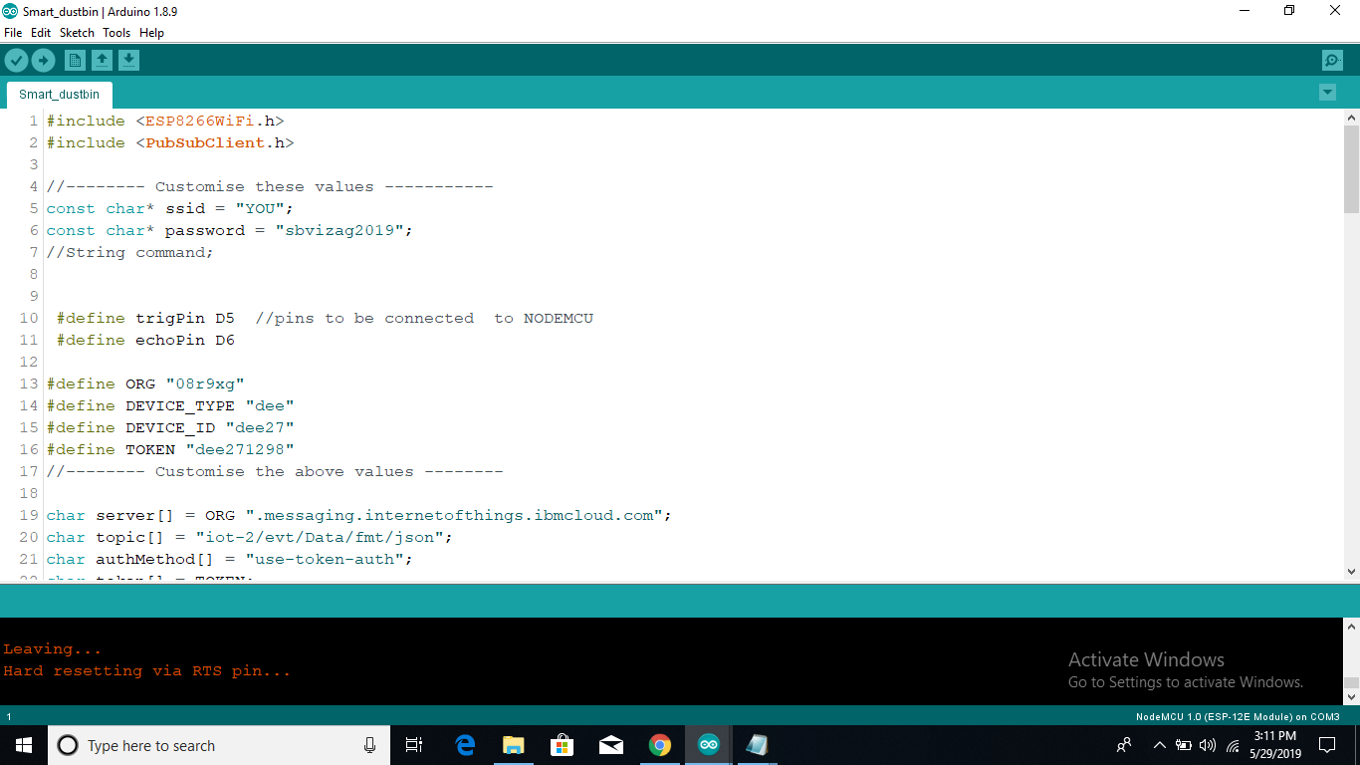
Software Requirments
Arduino IDE

Slide 10
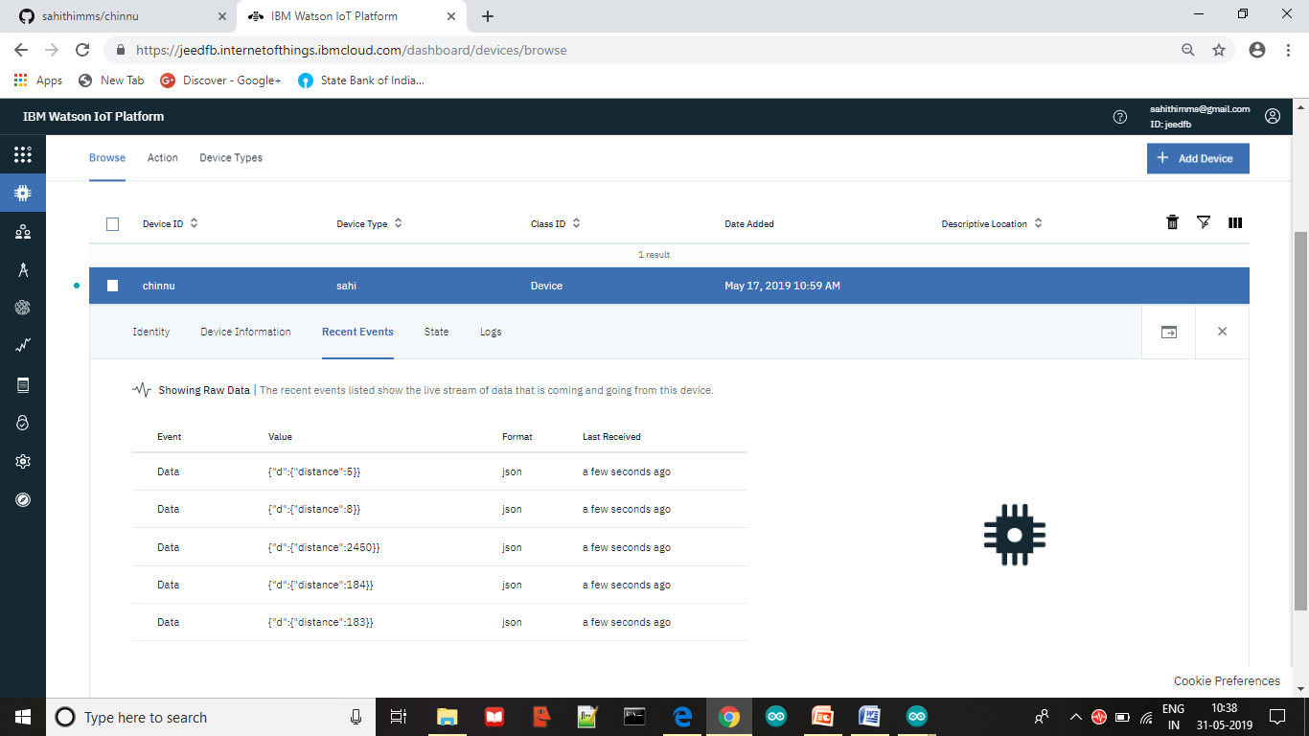
IBM Watson iot platform

Slide 11
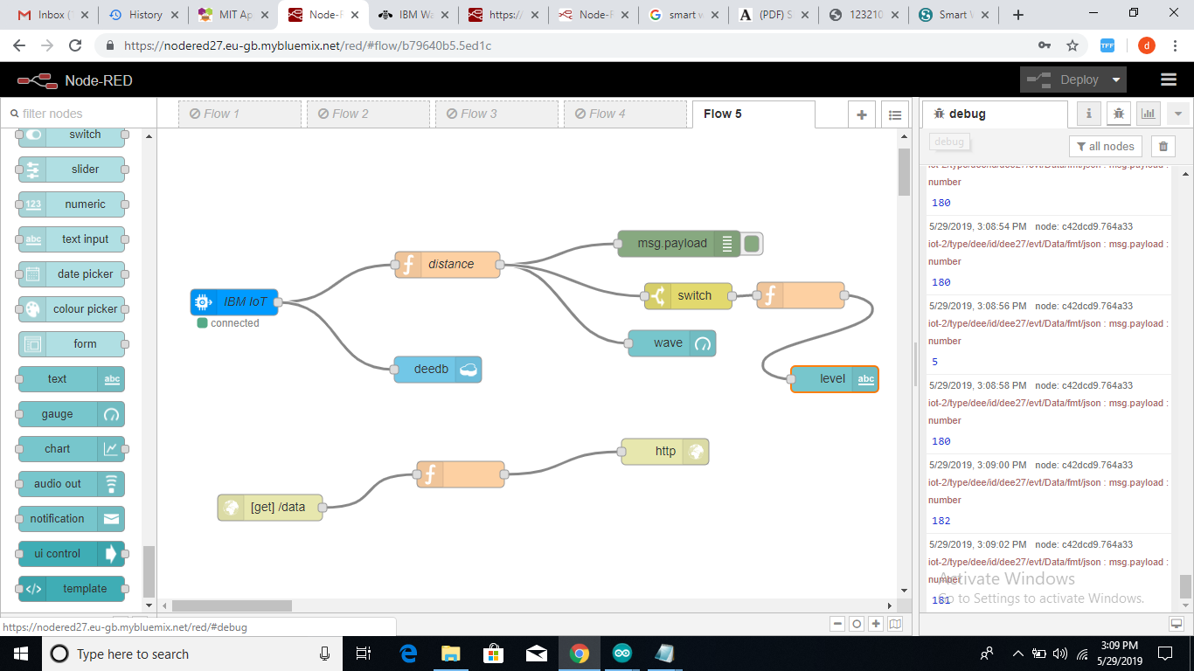
Node-RED

Slide 12
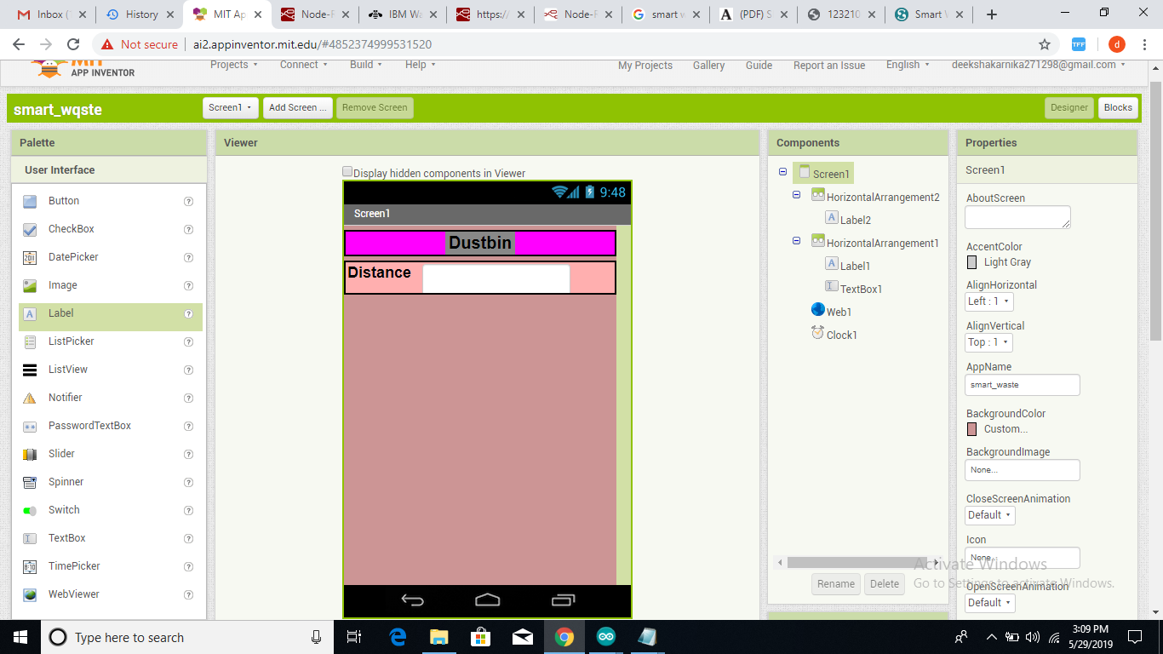
MIT App Inventor

Slide 13
Conclusion
We have implemented real time waste management system by using smart dustbins to check the level of bins whether it is full or not . In this system the information of bins can be accessed from anywhere and anytime by the particular person . By implementing this we can reduce cost reduction , air pollution and traffic in big cities . In some cities the garbage collecting vehicle visits and sometimes dustbins may not be full . Our system will inform the status of bin so that the authority can send vehicle when the bin is full.

Slide 14
